Slide 1
Neural ODE
Math 228A Final
By Xuesi Ruan and Longling Tian

Slide 2
Abstract
Introducing ODE solvers, neural networks, and neural ODEs
Euler’s method (ResNet) vs neural ODE (ODENet)
Backpropagation and the adjoint method
Application of neural ODE
Augmented neural ODE

Slide 3

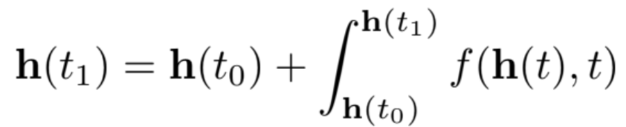

ODE Solvers
ODE:
Solve:
Euler’s method (small steps):

Slide 4
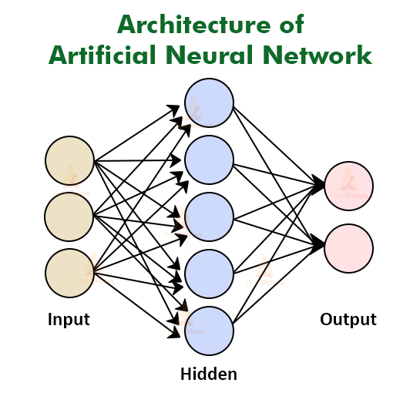
Neural Network
Artificial nodes
Imitate the operation of neurons in the human brain
Layers:
Input layer (receive numerical values)
Hidden layers (weights, biases, activation function)
Output layer (returns result)
Forward vs Back-propagation
Types of NN
Recurrent, convolutional, etc.

Slide 5
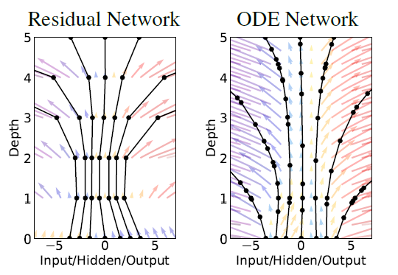
Neural ODEs
Blackbox ODE Solver
Learning structure instead of algorithms
ODESolve() for supervised learning
Compute gradients using the adjoint method
Ricky T. Q. Chen et al. Neural Ordinary Differential Equations. 2019.

Slide 6

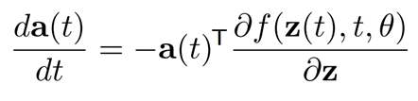
The Adjoint Method
We define loss function:
To minimize the cost function, we find the adjoint:
The Adjoint method / augmented ODE:
Ricky T. Q. Chen et al. Neural Ordinary Differential Equations. 2019.

Slide 7




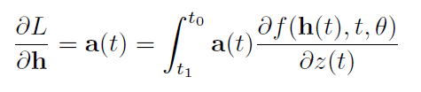
Back-propagation Algorithm
Compute by solving augmented ODE backwards, given
Compute with the adjoint backwards from
get the full trajectory of
Calculate the gradient with respect to the hidden layer dynamics:
Ricky T. Q. Chen et al. Neural Ordinary Differential Equations. 2019.

Slide 8
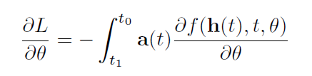
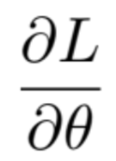
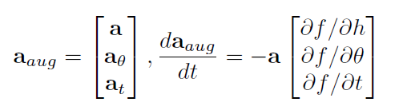
Augmented Adjoint State
Gradient with respect to parameter:
Concatenation of original state, adjoint state, and :
Single call to ODE solver
Automatic differentiation
Low time cost
Ricky T. Q. Chen et al. Neural Ordinary Differential Equations. 2019.

Slide 9

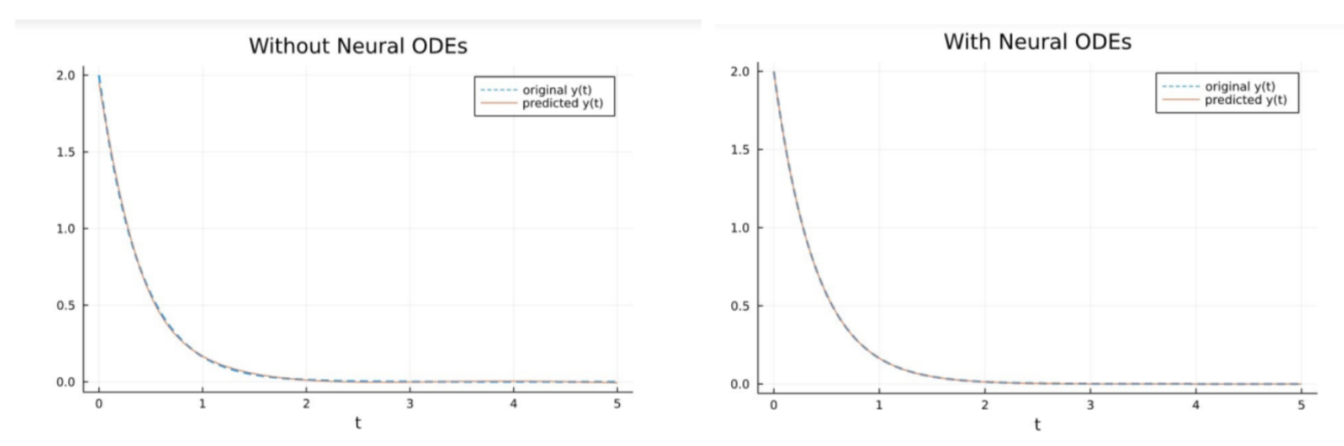
Discussion - Training Loss
Exponential model (RC circuit voltage) :

Slide 10
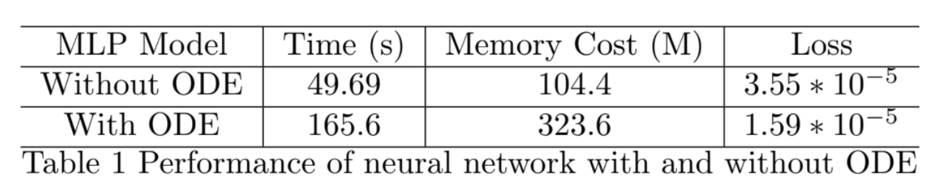
Training Loss (cont.)
Similar Accuracy
Without ODE has ⅓ of the memory cost

Slide 11
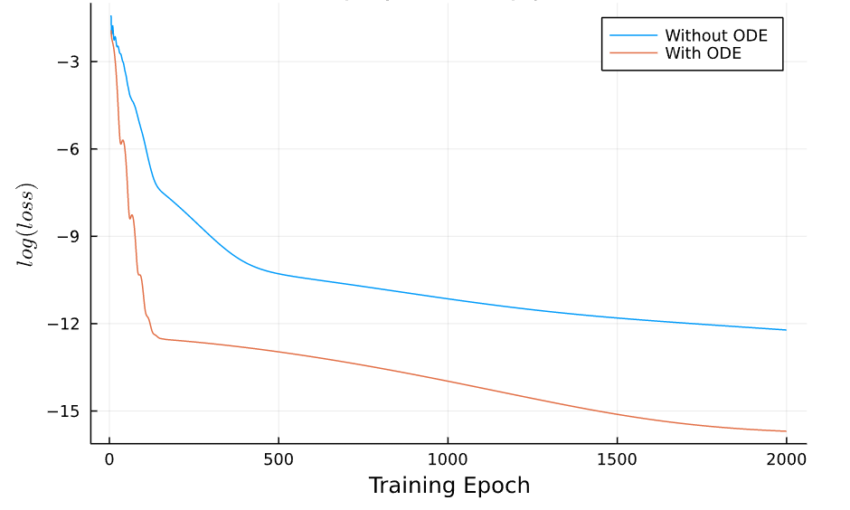
Training Loss Throughout the Process

Slide 12
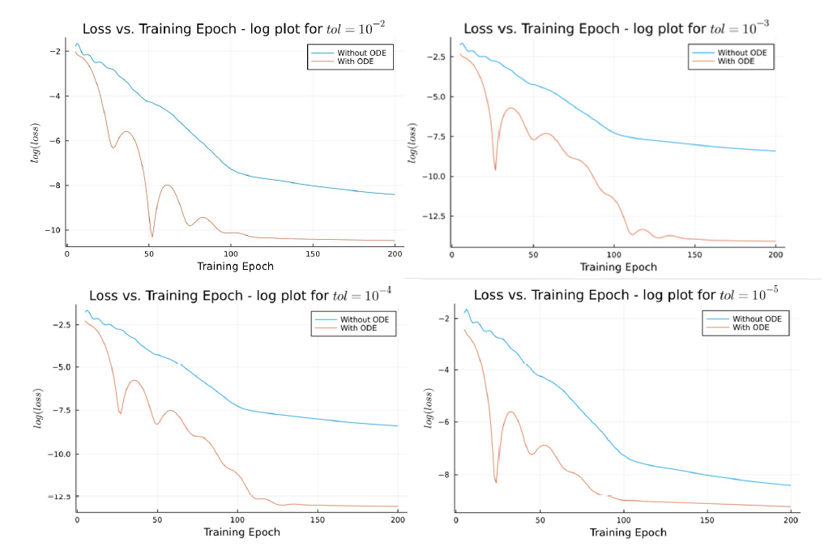
Tolerance Values
Neural ODE reduces training loss ~ 20 times
100 epoch: optimal setup
1e-3 ~ 1e-4: optimal tolerance setting

Slide 13
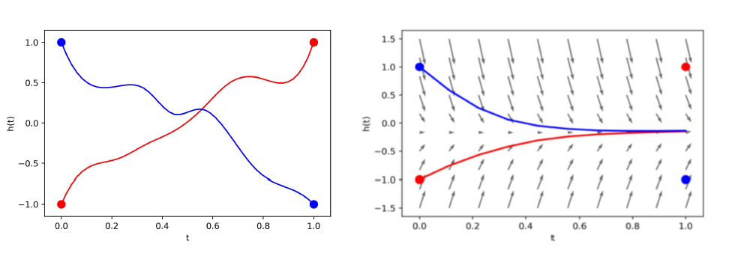
Drawback of Neural ODEs
Neural ODE fails when trajectories intersect:
Emilien Dupont, Arnaud Doucet, and Yee Whye Teh. Augmented Neural ODEs. 2019.

Slide 14
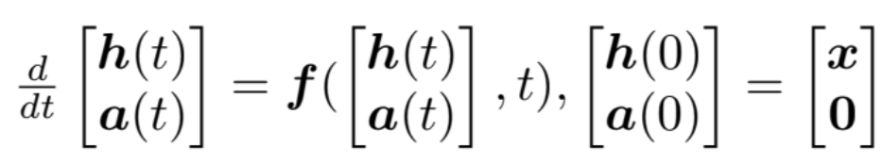
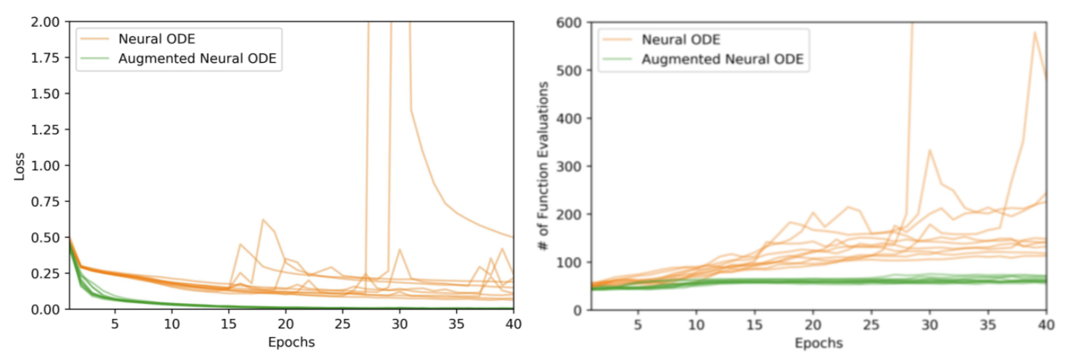
Augmented Neural ODE
ODE formatted as:
Emilien Dupont, Arnaud Doucet, and Yee Whye Teh. Augmented Neural ODEs. 2019.

Slide 15
Future Directions
Improved understanding of neural ODE augmentation
Neural ODEs for stiff equation
Second-order behavior of NODE
Adaptive control
Kim, Suyong, et al. "Stiff neural ordinary differential equations."
Norcliffe, Alexander, et al. "On second order behaviour in augmented neural odes."

